Slide 1
BDSN ET PROJECT ON SPARKS ML
Submitted by Pusparna Chakraborty a21024

Slide 2
Diabetes is a disease that occurs when your blood glucose, also called blood sugar, is too high. Blood glucose is your main source of energy and comes from the food you eat. Insulin, a hormone made by the pancreas, helps glucose from food get into your cells to be used for energy.

Slide 3
Can you build a machine learning model to accurately predict whether or not the patients in the dataset have diabetes or not?
Problem statement

Slide 4
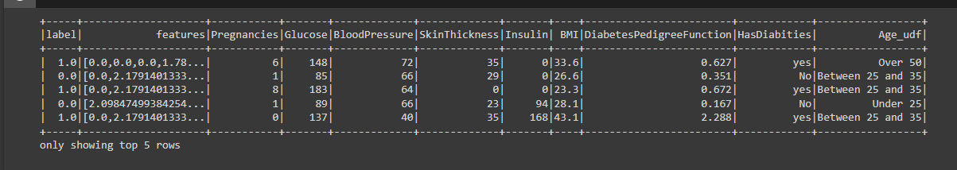
Context
This dataset is originally from the National Institute of Diabetes and Digestive and Kidney Diseases. The objective of the dataset is to diagnostically predict whether or not a patient has diabetes, based on certain diagnostic measurements included in the dataset. Several constraints were placed on the selection of these instances from a larger database. In particular, all patients here are females at least 21 years old of Pima Indian heritage.

Slide 5
Content
The datasets consist of several medical predictor variables and one target variable, Outcome. Predictor variables include the number of pregnancies the patient has had, their BMI, insulin level, age, and so on.
Pregnancies: Number of times pregnant
Glucose: Plasma glucose concentration a 2 hours in an oral glucose tolerance test
BloodPressure: Diastolic blood pressure (mm Hg)
SkinThickness: Triceps skinfold thickness (mm)
Insulin: 2-Hour serum insulin (mu U/ml)
BMI: Body mass index (weight in kg/(height in m)²)
DiabetesPedigreeFunction : Diabetes pedigree function
Age: Age (years)
Outcome: Class variable (0 or 1) 268 of 768 is 1, the others are 0

Slide 6
Procedure use for creating the model

Slide 7
Load Data
We can use the read() function similar to pandas to read data in csv format. We can manually specify the options;
header: If a data set has column headers, the header option is set to “True”.
Sep: Use the sep option to set the single character as a separator for each field and value. Our file is separated by “,”.
inferSchema: “inferSchema” automatically predicts the data type for each variable. If we specify “True” it will read a sample of data from the file to extract the schema. If it is defined as “False”, all the columns will be denoted as “string”. Hence, we will have to specify all the column data types by hand.

Slide 8
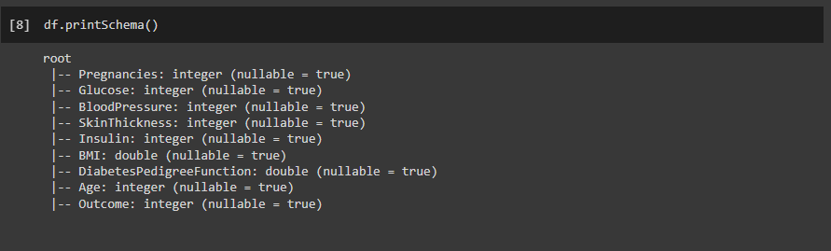
Data Exploration
Run the printSchema() function on the dataset to see the data types of the columns in the table.

Slide 9
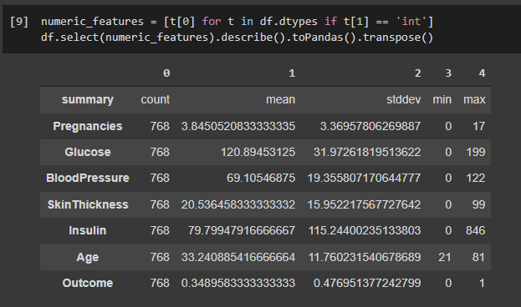
Statistics
Use the describe() function to extract the statistics of the numerical columns in the table.

Slide 10
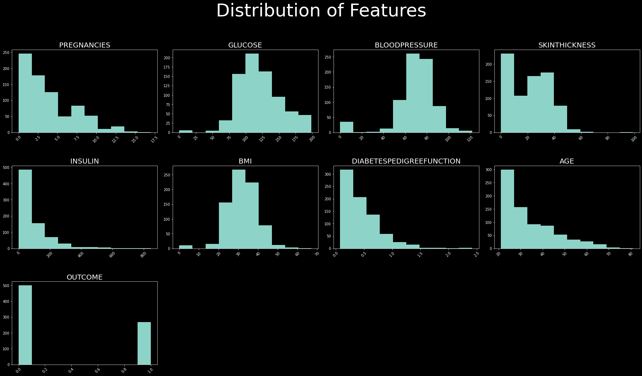
Exploratory Data Analysis

Slide 11
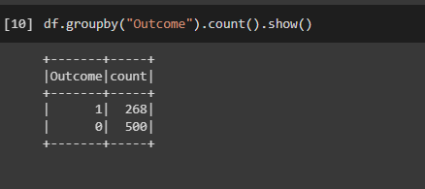
Target Variable Distribution
Our target variable is “Outcome”. This classification dataset does not have exactly equal number of instances in each class, but this difference is not important for now.

Slide 12
Feature Engineering
User Defined Functions (UDF)
We may want to make various transformations in our data. A User defined function(UDF) is a function provided by the user at times where built-in functions are not capable of doing the required work. We can use our UDFs for data manipulation.
a) Change Column Name and Convert the Target Variable (OutCome)
We want to change the “Outcome” values from 0 to “No”, and from 1 to “Yes”. We’ll use y_udf to change the name and the values of the target variable
Now, the data type of this column became “String”
b) Create a new column — Age Groups
Our goal is to create groups according to age ranges with the udf_multiple UDF.

Slide 13
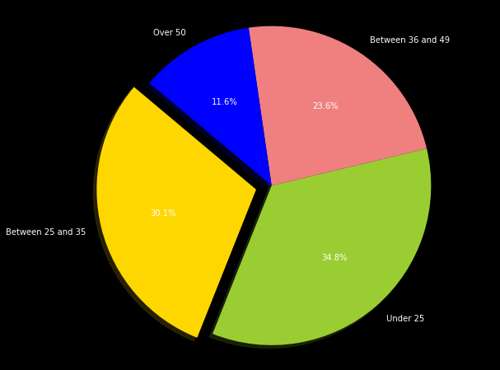
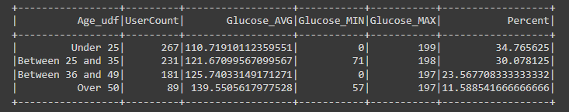
Window Function - Age Groups Distribution
We can use the “groupBy” and “Window” functions to see the Glucose distribution by age group. The Window allows us to see the percentage of each age group in the total dataset.

Slide 14
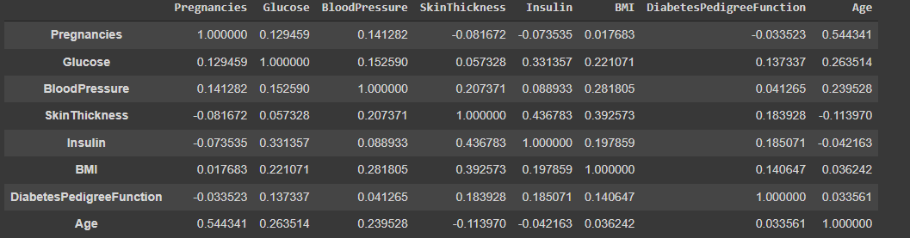
Pearson Correlation
We can use the PySpark statistics library to determine if there is a high correlation between our data. First of all, we determine the numerical columns and make a list of them into the “df_corr” dataframe
We checked whether there is a “pearson” correlation between numerical variables. As you can see,the highest correlation is 0,43 and between Insulin and SkinThickness. It’s obvious that there aren’t highly correlated numeric variables. Therefore, we will keep all of them for the model.

Slide 15
Getting Ready for Modelling
Firstly, we should apply 5 important transformers/estimators from the pyspark.ml library before we start to build the model.
After applying them, the data will be ready to build a model.
StringIndexer
OneHotEncoder
VectorAssembler
LabelIndexer
StandardScaler

Slide 16
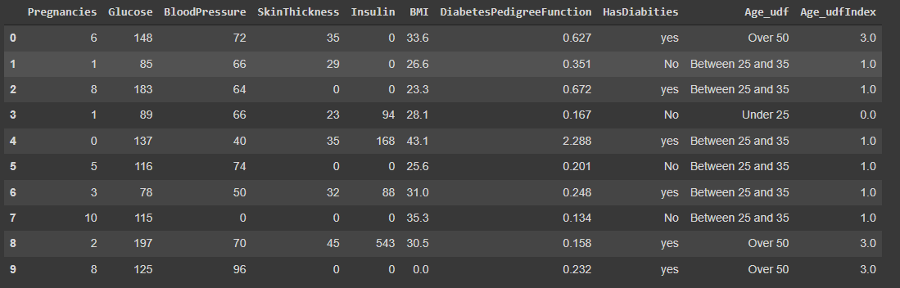
StringIndexer
StringIndexer converts a single column to an index column. StringIndexer simply replace each category with a number. The most frequent values gets the first index value(0.0). As we see below, “Under 25” has taken 0.0 index value. “Over 50” group has the least population in our dataset. It takes the biggest index value.

Slide 17
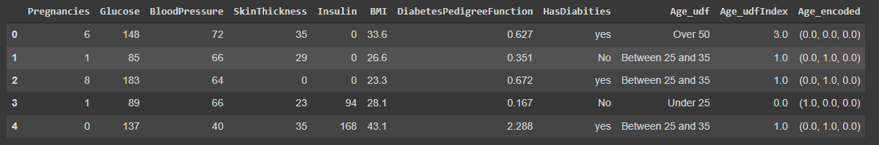
OneHotEncoder
We use “OneHotEncoderEstimator” to convert categorical variables into binary SparseVectors.
With OneHotEncoder, we create a dummy variable for each value in categorical columns and give it a value 1 or 0. This method produces different results with pandas. If we made this transform on Pandas, 4 new columns would be produced for four groups. However, 3 columns are produced on Spark. If our age group is “Over 50+”, then Age_encoded will be (0.0,0.0,0.0)

Slide 18
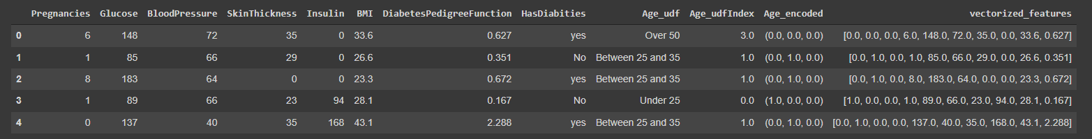
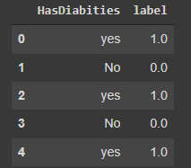
VectorAssembler
Transform all features into a vector using VectorAssembler.
Convert label into label indices using the StringIndexer.
“No” has been assigned with the value “0.0”, “yes ”is assigned with the value “1.0”.
LabelIndexer

Slide 19
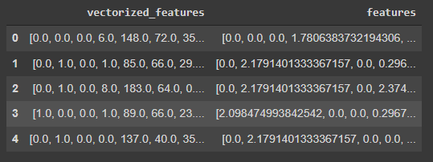
StandardScaler
Standardization of a dataset is a common requirement for many machine learning estimators: they might behave badly if the individual features do not look like more or less normally distributed data (e.g. Gaussian with 0 mean and unit variance).
StandardScaler standardize features by removing the mean and scaling to unit variance.

Slide 20
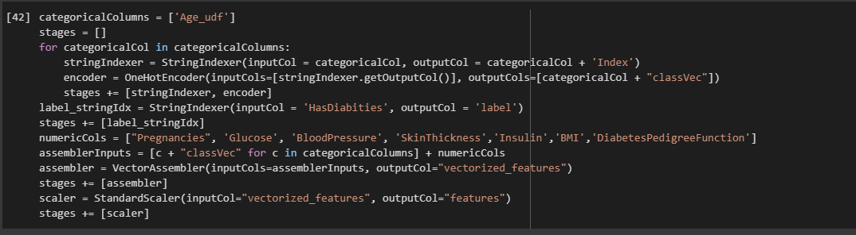
Model Pipeline
We use pipeline to chain multiple Transformers and Estimators together to specify our machine learning workflow. A Pipeline’s stages are specified as an ordered array.
An Easier Way To Build Pipeline
First of all we determine categorical columns. Then,it indexes each categorical column using the StringIndexer. After that, it converts the indexed categories into one-hot encoded variables. The resulting output has the binary vectors appended to the end of each row. We use the StringIndexer again to encode our labels to label indices. Next, we use the VectorAssembler to combine all the feature columns into a single vector column. As a final step, we use StandardScaler to distribute our features normally.

Slide 21
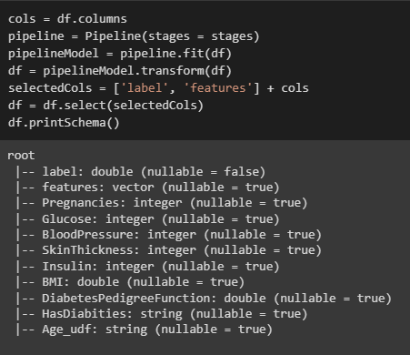
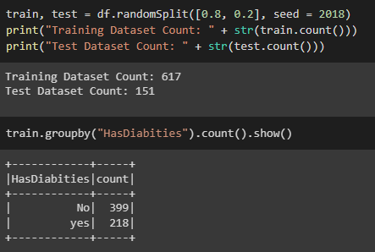
Run the stages as a Pipeline. This puts the data through all of the feature transformations we described in a single call.
Train / Test Split

Slide 22
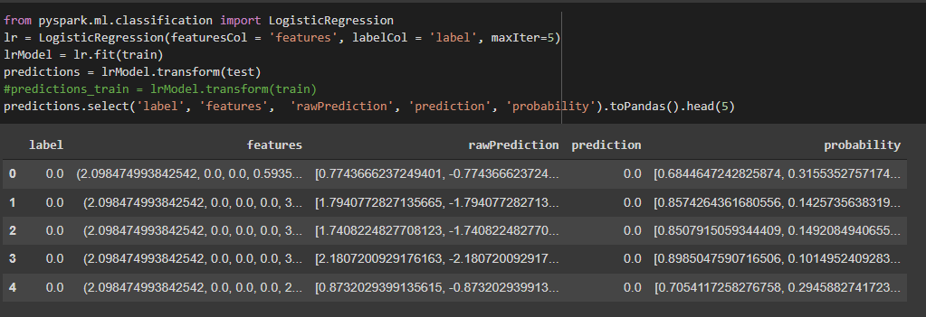
Model Training
Logistic Regression It is used in statistical software to understand the relationship between the dependent variable and one or more independent variables by estimating probabilities using a logistic regression equation. This type of analysis can help you predict the likelihood of an event happening or a choice being made.

Slide 23
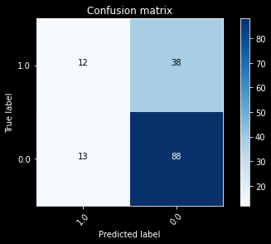
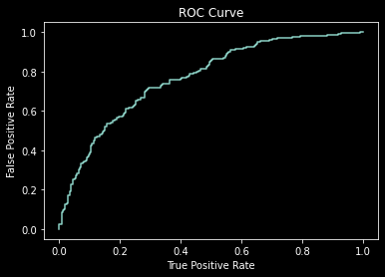
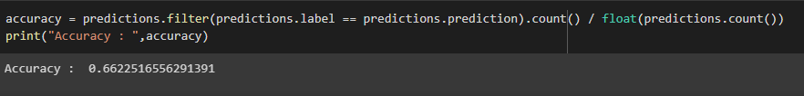
Model Evaluation
Confusion Matrix
ROC is a probability curve and AUC represents degree or measure of separability. ROC tells how much model is capable of distinguishing between classes. Higher the AUC, better the model is at distinguishing between patients with diabetes and no diabetes.

Slide 24
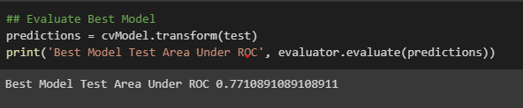
Best Model Performance
Cross Validation and Parameter Tuning
Now we will try tuning the model with the ParamGridBuilder and the CrossValidator
As we indicate 3 values for regParam (Regularization Parameter), 3 values for maxIter (Number of iterations), and 2 values for elasticNetParam (Elastic Net Parameter ), this grid will have 3 x 3 x 3 = 27 parameter settings for CrossValidator to choose from. We will create a 5-fold cross validator.

Slide 25
THANK YOU

